Slide 1


Department of Artificial Intelligence and Data Learning
FitMaster: Smart Workout Planning
Dr.J.Manoranjini
Associate Professor
Kowshik 221801025
Nikilesh 221801035

Slide 2
Introduction
Overview:A user-friendly platform designed to help individuals create and track personalized workout plans based on specific fitness goals, with exercises categorized by muscle groups.
Objective:Empower users to build and adjust custom routines that align with their fitness journeys.
Scope:Offers workout templates, a "Plan Your Workout" tool, and progress tracking, with a responsive design for both desktop and mobile

Slide 3
Existing Systems
Overview:Current fitness planning methods include generic workout apps, gym trainers, and online videos that provide limited customization and guidance for personalized fitness goals.
Limitations:Existing fitness platforms often lack personalized routines that cater to individual goals and fitness levels, limiting users to a narrow range of exercises. Many have non-intuitive interfaces, making navigation difficult. Additionally, they lack effective progress tracking, hindering users from monitoring improvements and staying motivated.

Slide 4
Advantages and Disadvantages of Existing System
Advantages of Existing System
Familiarity
Established User Base
Personalized workout plan
Disadvantages of Existing System
Lack of Personalization
Limited Exercise Variety
Non-User-Friendly Interfaces
Ineffective Progress Tracking

Slide 5
Proposed System
Frontend:HTML, CSS, JavaScript
Backend:Node.js, Express.js, MongoDB
Key Features:
Personalized Plans: Customized workouts based on individual goals
Exercise Library: Extensive database with descriptions and videos
Technical Considerations: Responsive, secure, high-performance, user-friendly, and accessible

Slide 6
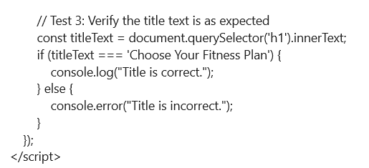
Advantages and Disadvantages of Proposed System
Advantages:
Personalized Workouts: Users can create tailored workout plans that suit their specific fitness goals and preferences.
User-Friendly Interface: The platform is easy to navigate, making it accessible for beginners and experienced users alike.
Comprehensive Exercise Library: Offers a wide variety of exercises categorized by muscle groups, helping users target specific areas.
Customization Flexibility: Users can add or remove exercises, adapting their routines as they progress.
Disadvantages:
Initial Setup Effort: Requires initial time and effort to set up personalized plans, which might be challenging for beginners.
User Dependency on Self-Motivation: Without community features or reminders, users need strong self-discipline to stay consistent.
Potential Complexity: Users unfamiliar with workout planning may find some advanced features overwhelming at first.

Slide 7
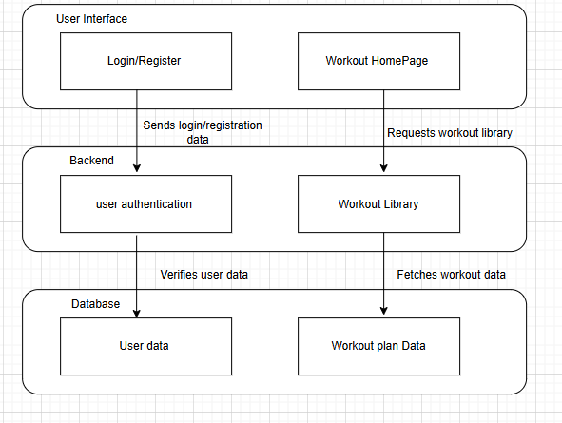
Architecture

Slide 8
List of Modules :
User Authentication Module
Workout Library Module
Custom Workout Plan Module
Exercise Logging Module.

Slide 9
Modules :
User Authentication Module
Handles user registration, login, password reset, and profile management.
Workout Library Module
Provides a library of workouts categorized by muscle group, exercise type, or difficulty level.
Allows users to browse and select workouts based on their preferences.
Custom Workout Plan Module
Enables users to create personalized workout plans based on their fitness goals and schedules.
Offers options for adding exercises, adjusting difficulty, and scheduling.
Exercise Logging Module
Allows users to log completed exercises, including reps, sets, and duration.
Offers functionality for quick logging to streamline the process.

Slide 10
Functionality Testing :
Functionality testing is a type of software testing that ensures a system or component behaves as expected according to its requirements. In this context, functionality testing involves checking that each feature on the website—such as navigation links, buttons, forms, and interactive elements—works correctly. For example, in your e-commerce platform, functionality testing would verify that:
Links and buttons direct users to the correct pages.
The carousel for workout categories works smoothly.
Custom workout plans display correctly when users make selections.
JavaScript functions, like handling click events and dynamically loading content, perform as intended.

Slide 11
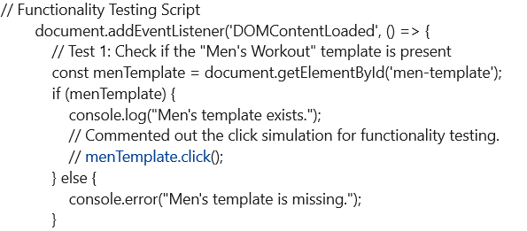
Functionality Testing:

Slide 12
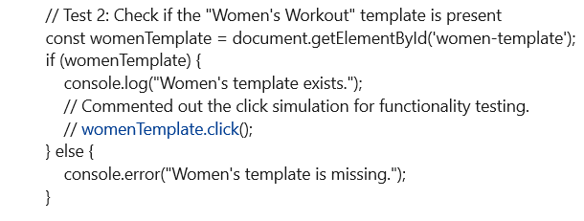
Functionality Testing:

Slide 13
Functionality Testing :
.

Slide 14

Functionality Testing:

Slide 15
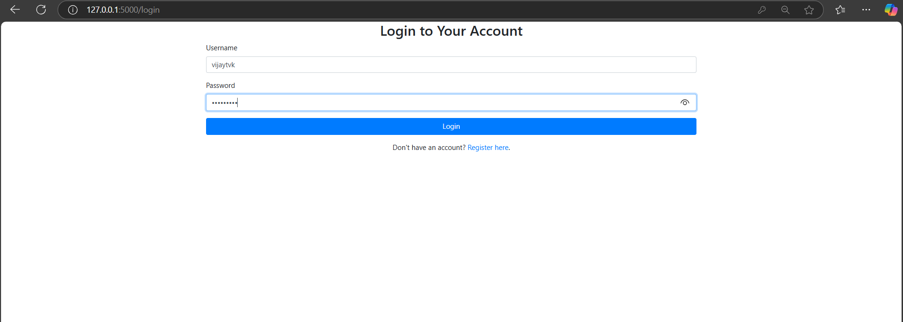
Login Page:

Slide 16
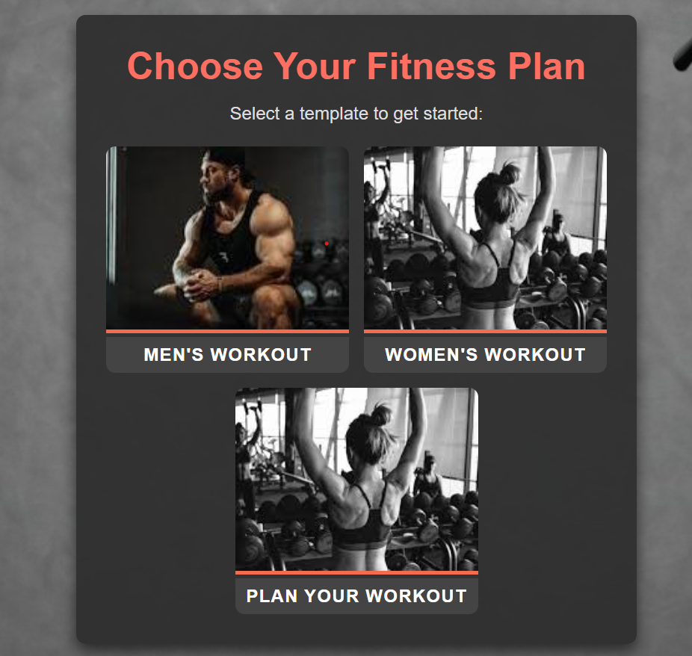
Workout Homepage:

Slide 17
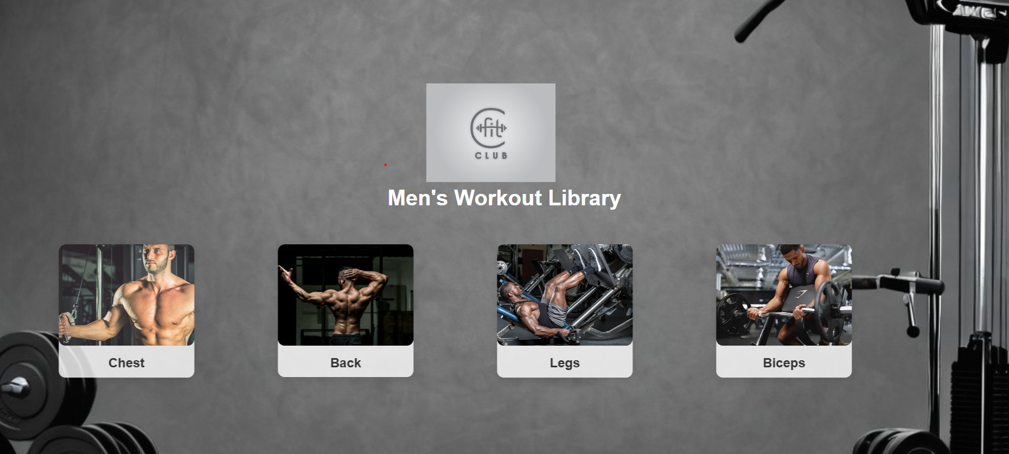
Output:

Slide 18
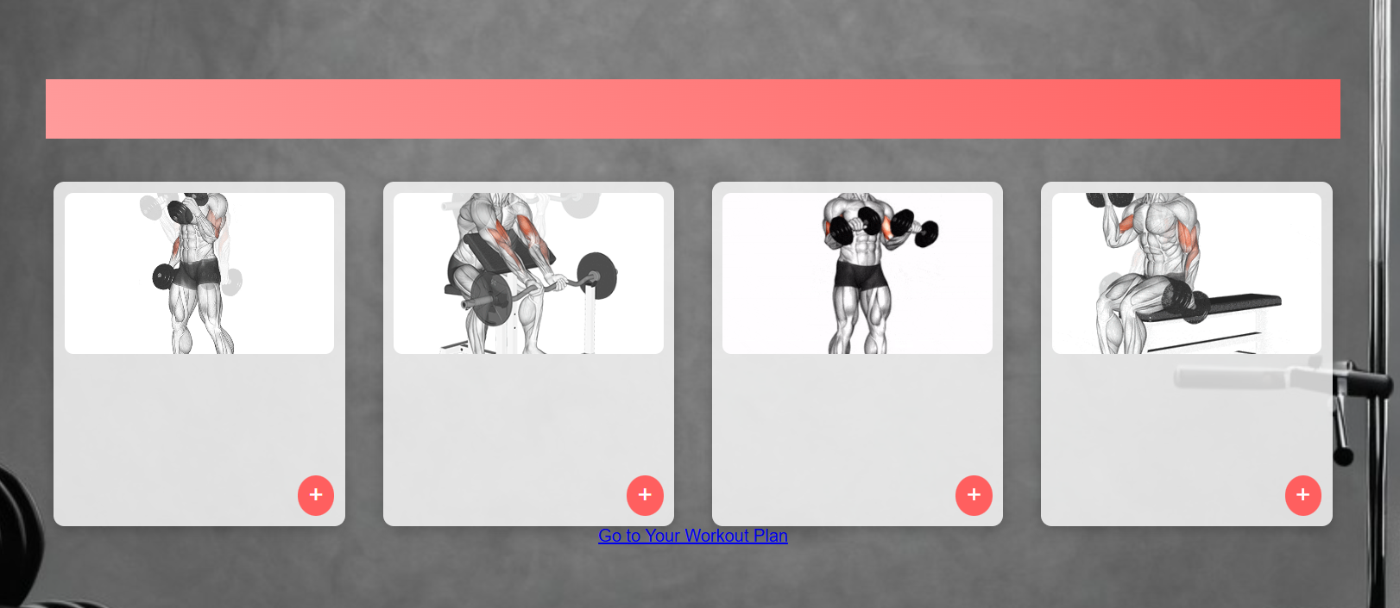
Output

Slide 19
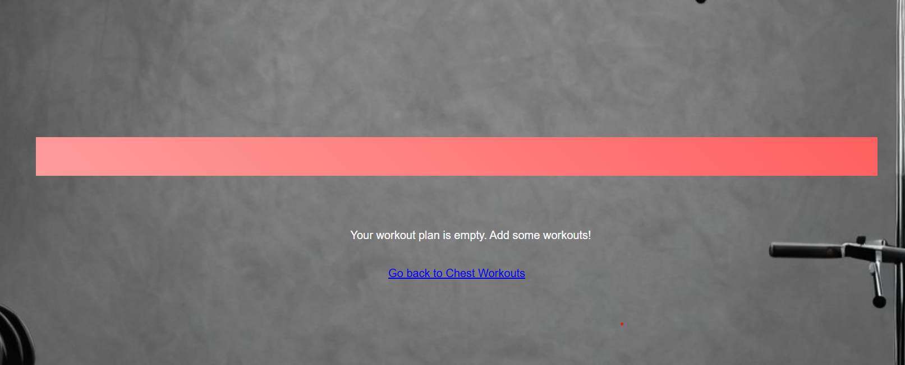
Workout plan page:

Slide 20
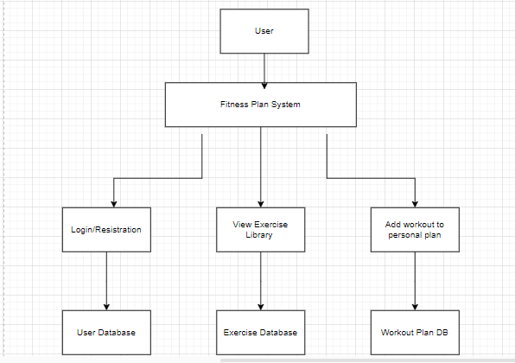
Data Flow Diagram

Slide 21
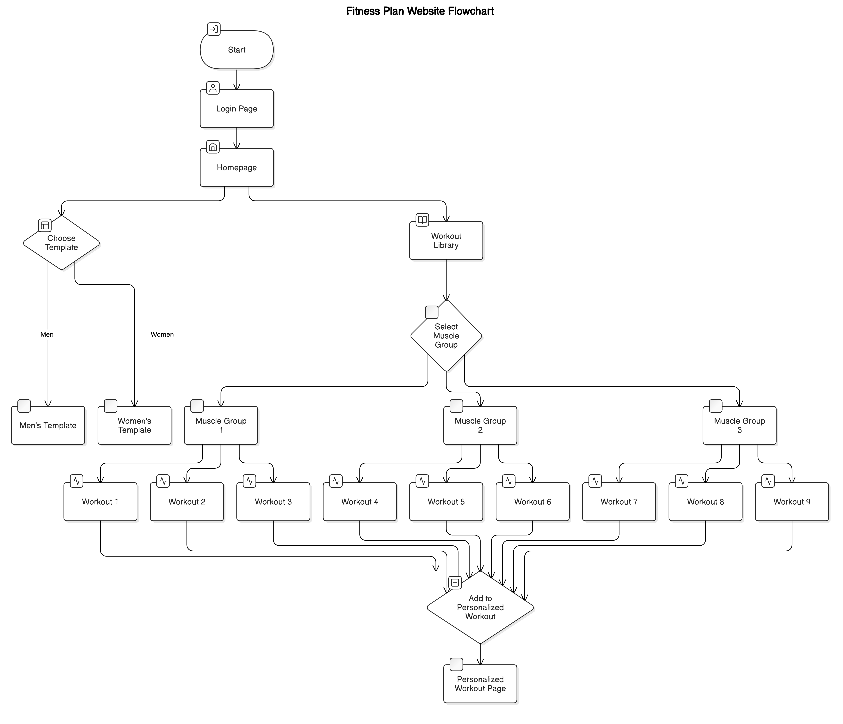
Object Oriented Design

Slide 22
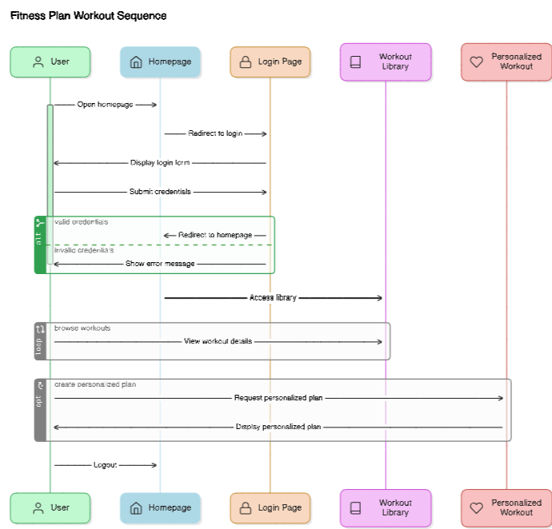
Sequence Diagram

Slide 23
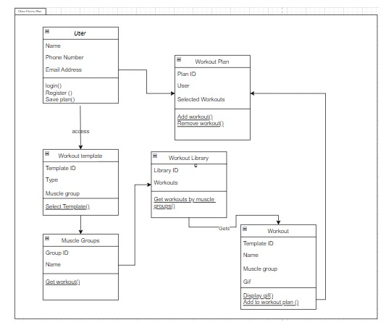
UML Diagram

Slide 24
Conclusion
The fitness plan platform offers a personalized, user-friendly solution for designing and tracking workout routines. By providing customizable templates, categorized exercise libraries, and progress tracking, the system empowers users to stay committed to their fitness goals. Its accessible design and flexibility support users at all fitness levels, making it a comprehensive tool for achieving and maintaining a healthy lifestyle. Additionally, the platform's scalability allows for future enhancements, such as instructional videos, community features, and advanced progress analytics, to further enrich the user experience

Slide 25
References
"Design and Implementation of a Fitness Training Web Application" – Published in the International Journal of Advanced Computer Science and Applications (IJACSA), 2021. This paper discusses web-based fitness app design and implementation.
"User-Centered Design of a Web-Based Fitness Platform" – Journal of Usability Studies, 2019. Covers best practices in creating user-friendly interfaces for fitness and wellness websites.
"Online Personal Training: A New Avenue for Fitness" – American College of Sports Medicine, 2020. Provides insights into virtual fitness guidance and user engagement.
"Effectiveness of Personalized Exercise Recommendations in Digital Health Apps" – Journal of Medical Internet Research, 2022. Examines the impact of personalized exercise plans on user adherence.
W3C Web Accessibility Initiative (WAI) – Guidelines on making web content more accessible and user-friendly, applicable to fitness websites.

Slide 26
Thank You

